Slide 1
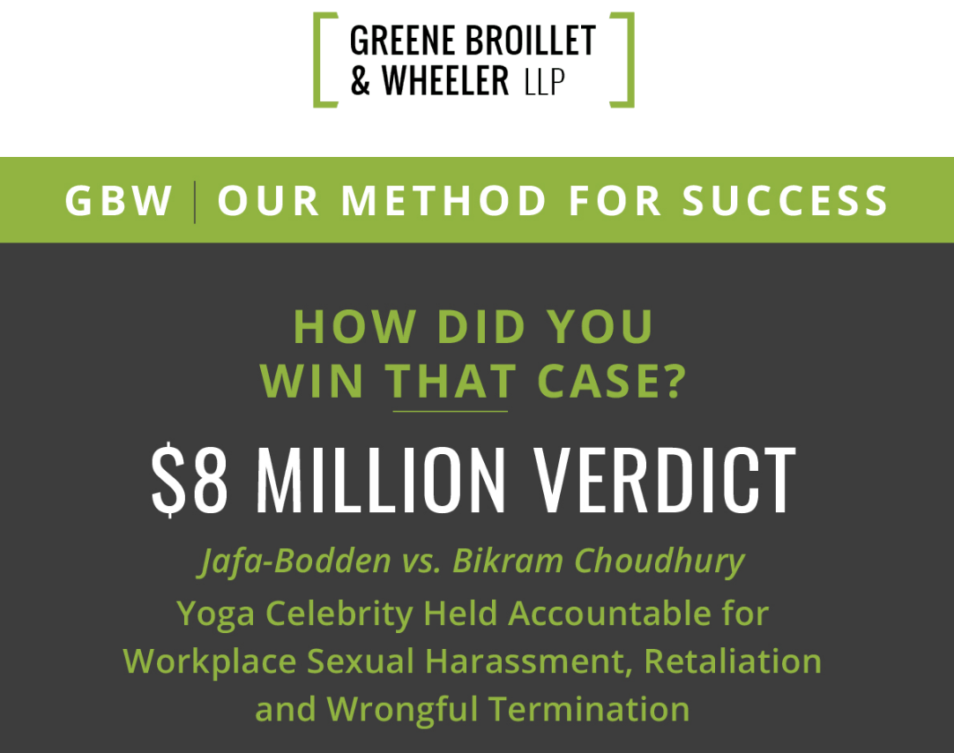
Mark Quigley & Aaron Osten, Greene Broillet & Wheeler, LLP
Carla Minnard, The Minnard Law Firm

Slide 2



Slide 3
OVERVIEW OF TOPICS & INTRODUCTION
HISTORY – Facts & Circumstances leading up to the Bodden case
THE LAW - FEHA CLAIMS/PUBLIC POLICY/LABOR CODE 1102.5
DEFENSES & ISSUES UNIQUE TO “CELEBRITY” DEFENDANTS
DAMAGES
POST-VERDICT: Appeals & Collection

Slide 4

HISTORY
Pandhora Williams v. Bikram Choudhury 2011
Nature of Case & Claims
FACTS:
9 week Teacher Training in San Diego - $12,000
Must be referred by certified instructor/studio owner
Certification to Teach
Pattern of Abuse & Outrageous Conduct
PW Thrown out for asking a question
Ostracized, removed from hotel, refused to refund $$$
LEGAL CLAIMS:
Race discrimination – Unruh Civil Rights Act
Breach of Contract
Assault & Battery
Negligent Hiring, Retention & Supervision

Slide 5
HISTORY
Pandhora Williams v. Bikram Choudhury 2011
Nature of Case & Claims
Pattern of litigation abuse:
30+ law and motion matters
Revolving door of attorneys
Four Motions to Continue Trial
Trial began April 2013
Subpoena to Micki Bodden – Head of Legal & International Affairs - Terminated
Case needed local Co-Counsel: Greene, Broillet & Wheeler

Slide 6
THE LAW
3 Categories
Common Law Claims
Wrongful Termination in Violation of Public Policy
FEHA Claims
  Gender Discrimination & Harassment
  Hostile Work Environment
  Failure to prevent
3. Labor Code 1102.5
Whistleblower Retaliation

Slide 7
DEFENSES & ISSUES UNIQUE TO CELEBRITY DEFENDANTS
Affirmative Defenses
Administrative Exhaustion
Statute of Limitations
No employer/employee relationship
Same decision
After acquired evidence
Attorney client privilege
Avoidable consequences
Fifth Amendment Privilege

Slide 8
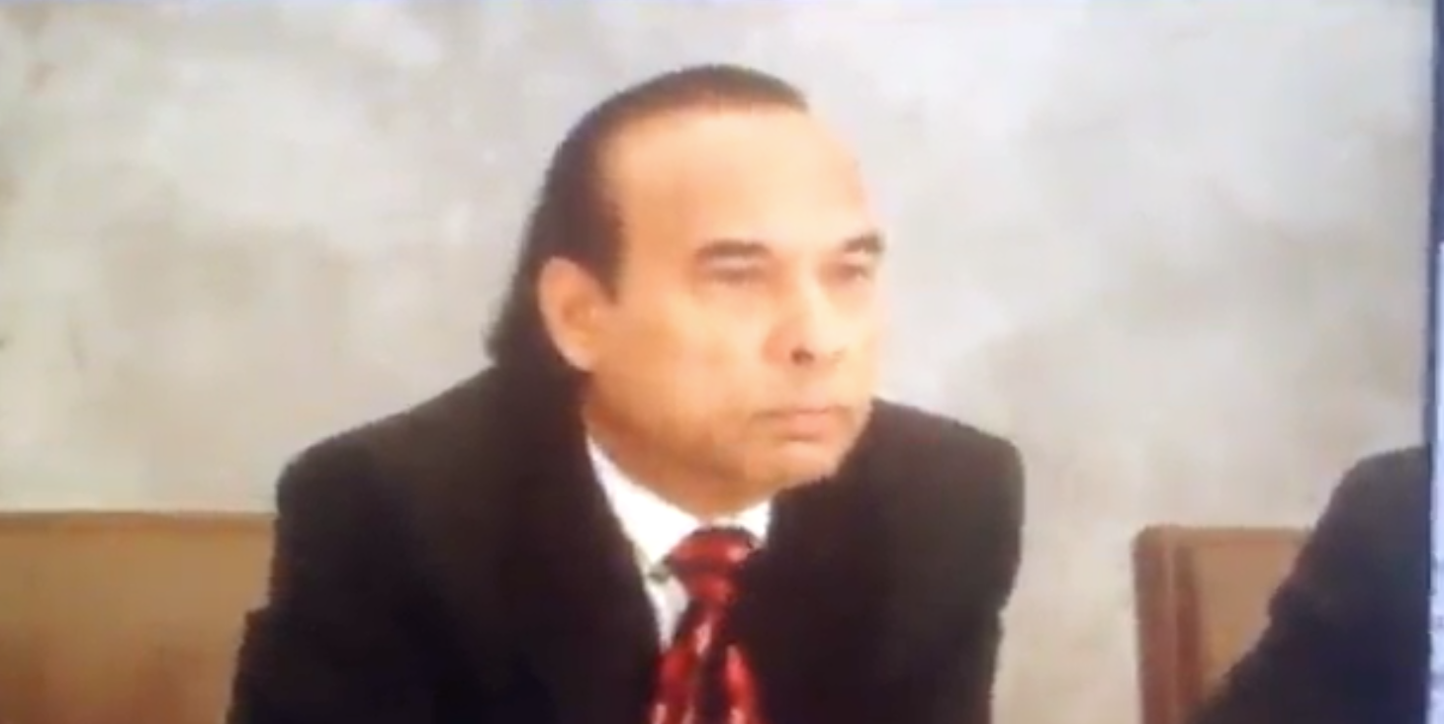
DEFENSES & ISSUES UNIQUE TO CELEBRITY DEFENDANTS – DEPOSITION CLIP

Slide 9
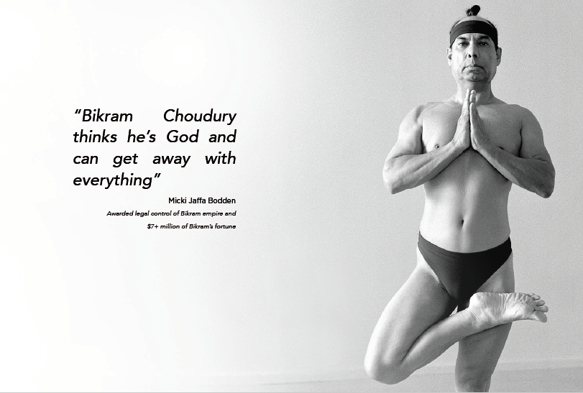
DEFENSES & ISSUES UNIQUE TO CELEBRITY DEFENDANTS
Defenses Unique to cases involving “Celebrity” Defendants
Deep pocket
Name dropping
Jurors & Star shine
POWER: $$$, Death threats, theft, witness intimidation
God complex

Slide 10
Damages Issues
What damages is your client entitled to?
1. Economic
2. Non economic
3. Punitive
4. Attorneys’ Fees

Slide 11
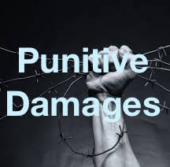
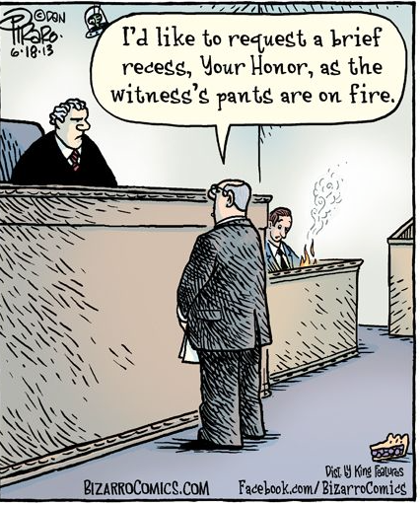
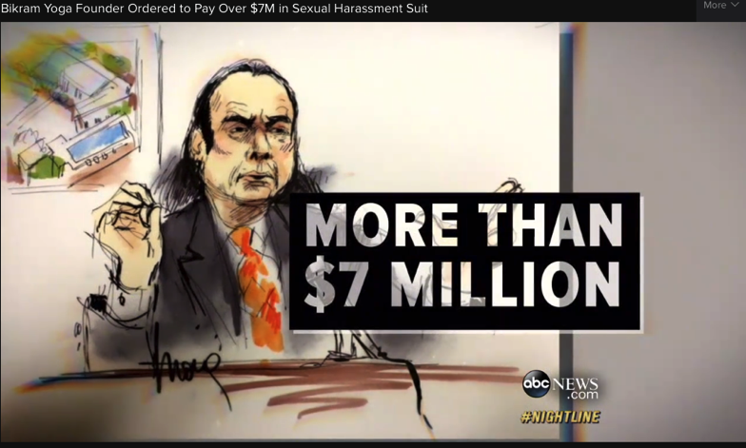
Damages Issues
How to determine the net worth of a celebrity defendant

Slide 12
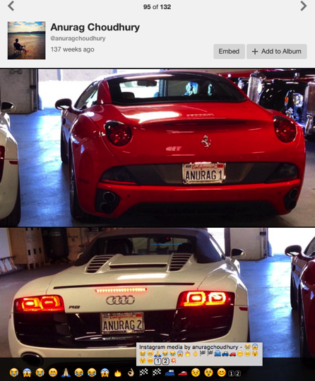
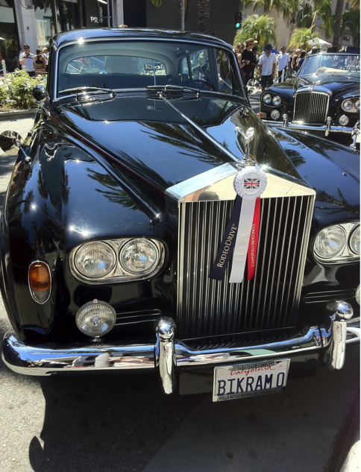
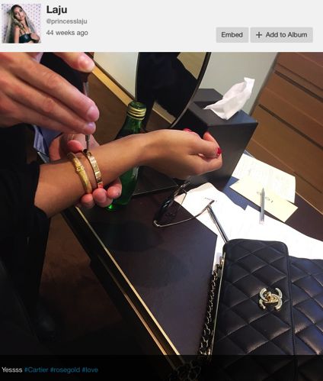
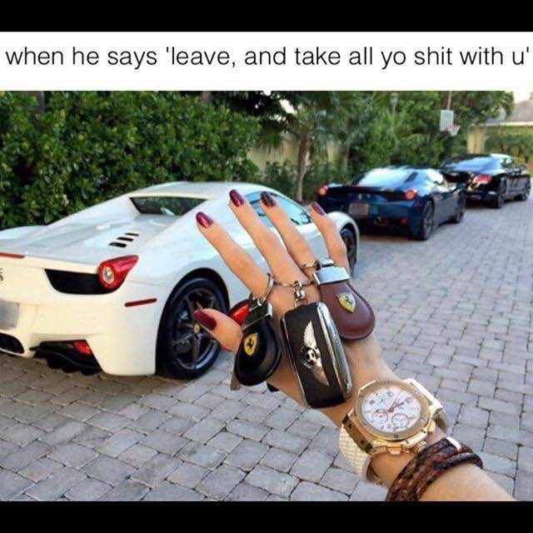
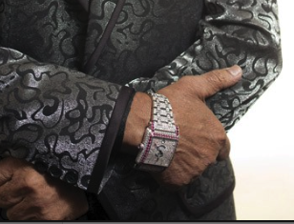
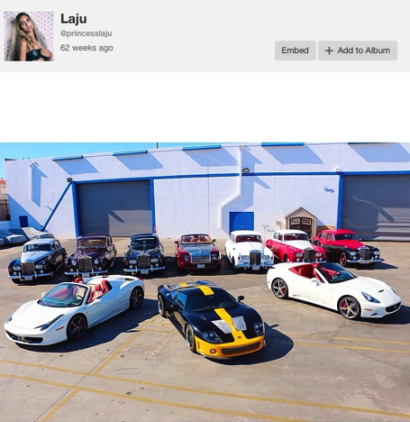
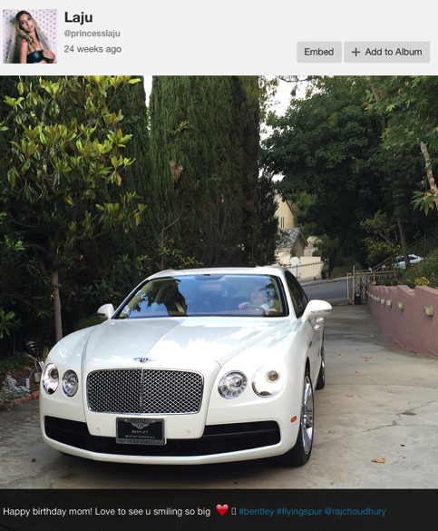
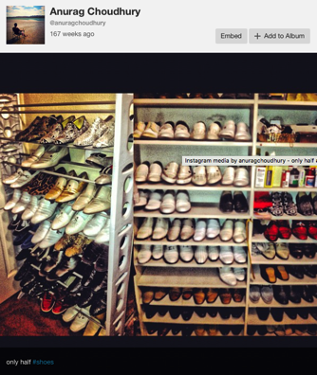
Using Social Media/Press/Internet
Instagram
Facebook
Website
YouTube
Press Interviews
**

Slide 13
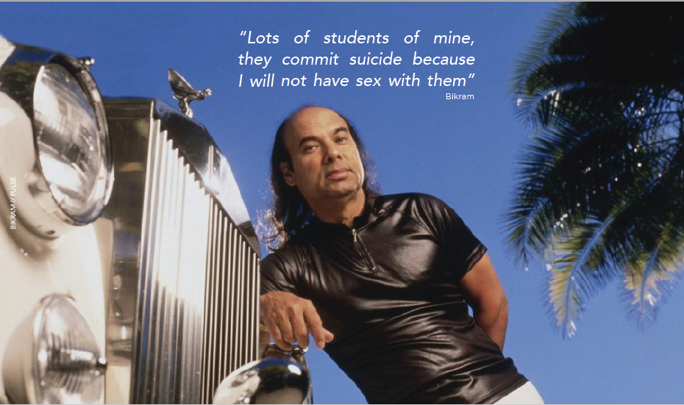
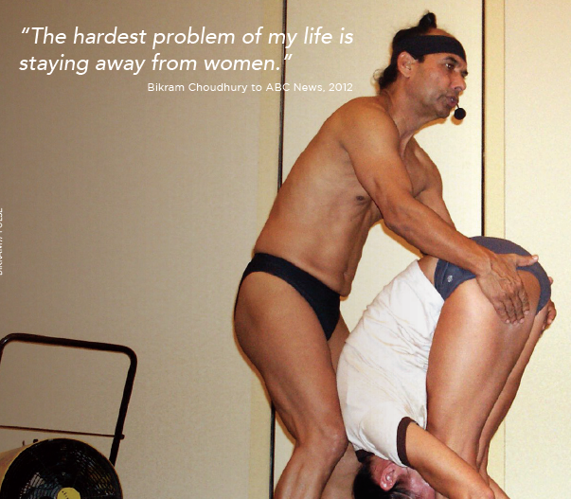
With a celebrity defendant, often their
own press interviews can be used.

Slide 14
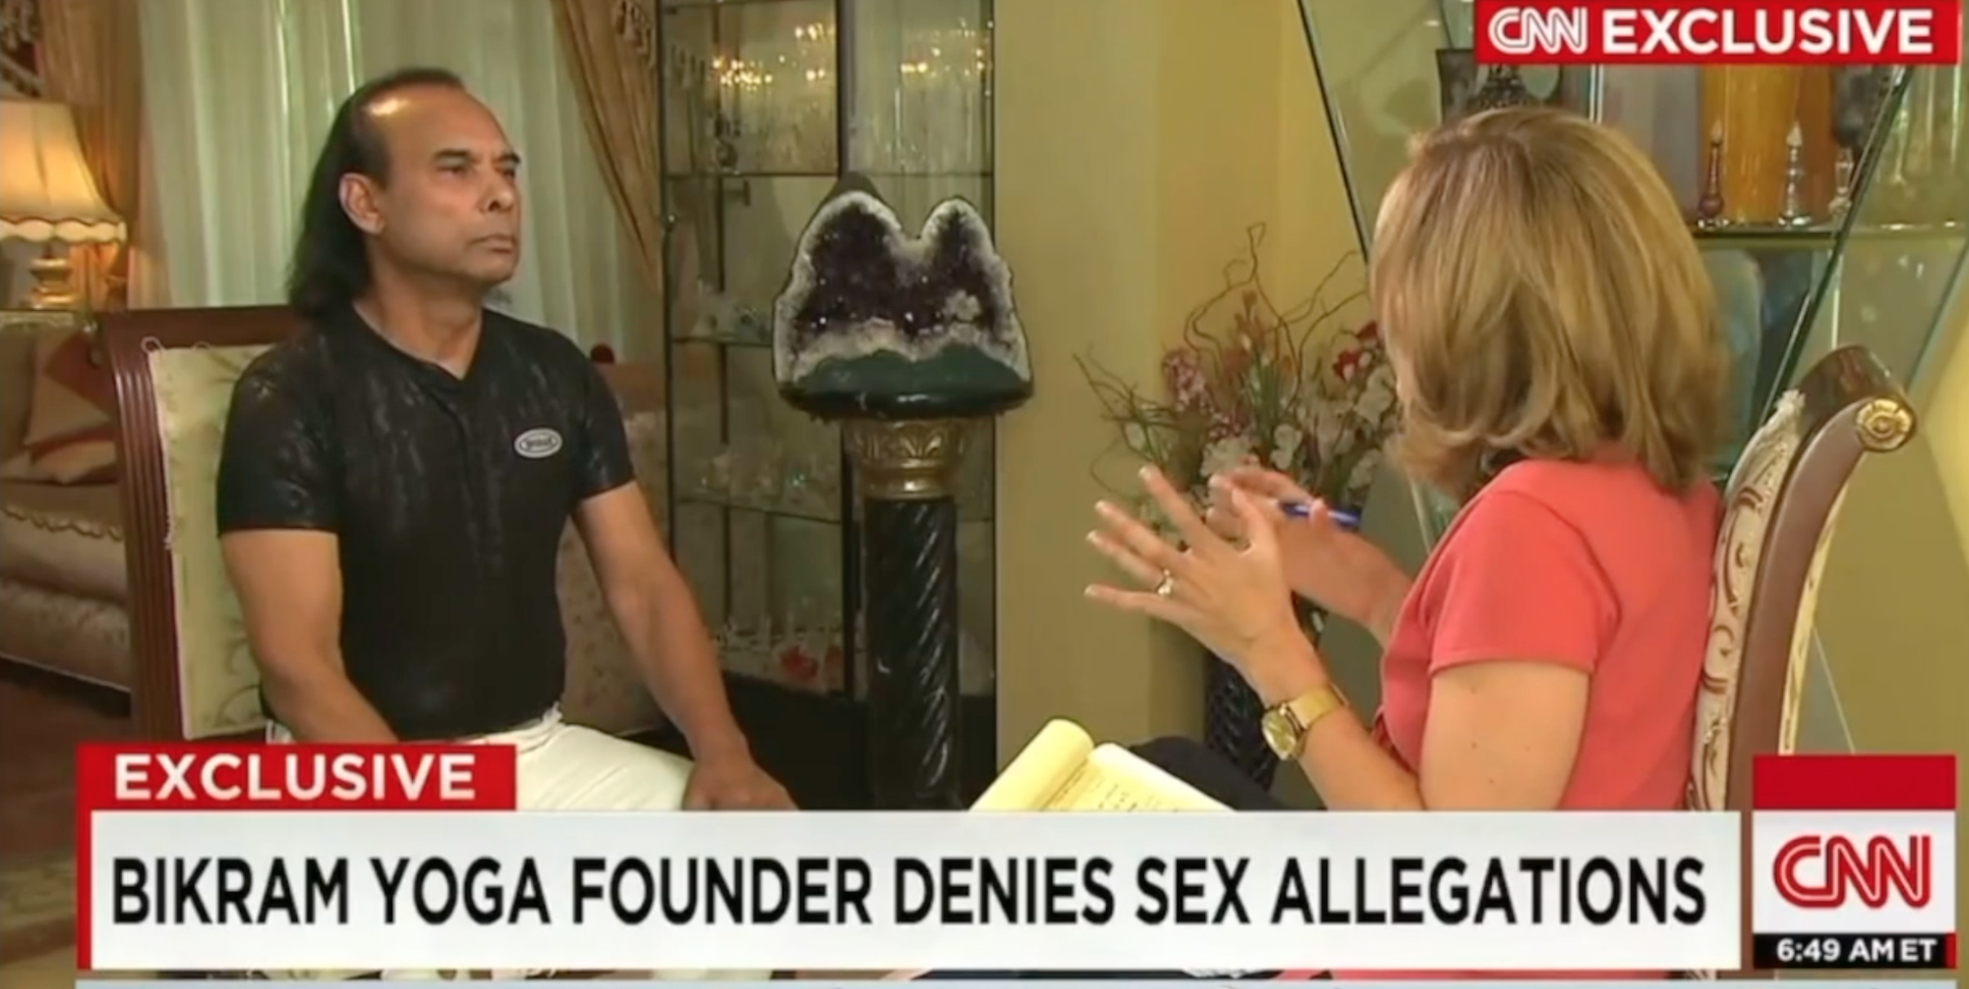
CNN INTERVIEW

Slide 15
POST VERDICT: APPEALS & COLLECTIONS
Bodden v. Choudhury
Appeal – Fully Briefed, filed Motion to Dismiss
Collections
Warrant - $8 million bail
Bankruptcy
Tracking cars all over the country
Cases and work all over the world (Mexico, Japan, Thailand, Cayman Islands)

Slide 16
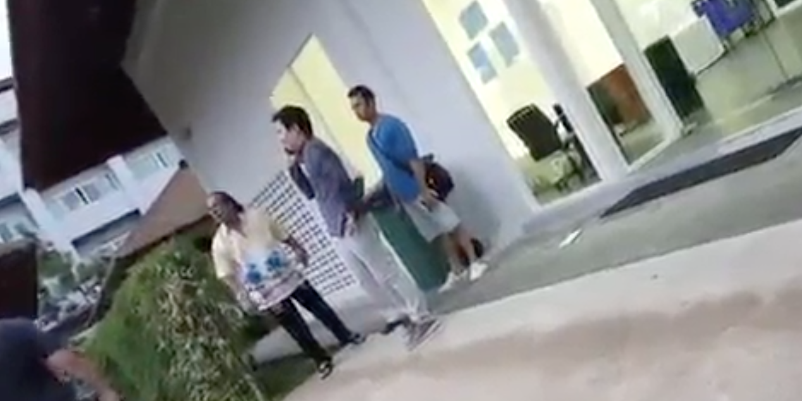
POST VERDICT: APPEALS & COLLECTIONS
VIDEO OF SERVICE IN THAILAND

Slide 17
CONCLUSION / QUESTIONS
Mark Quigley– mquigley@gbw.law
Aaron Osten– aosten@gbw.law
Carla Minnard– carlaminnard@minnardlaw.com

Slide 18



